Slide 1


SQL Injection
Stephen Frein
Comcast

Slide 2
Introduction
About Me
  Software development manager @ Comcast
  Web / database development background
  CISSP and some other alphabet soup
  http://www.linkedin.com/in/stephenfrein
About the Presentation
  So, about the "Hands-on" part . . .
  SQL knowledge helpful

Slide 3
Topics Covered
What is SQL Injection?
Why is it a big deal?
What makes applications vulnerable to it?
What is the general strategy of an attack?
What would a sample attack look like?
How can attacks be prevented?

Slide 4

Take-Aways
If only I had gone to Frein's talk …
SQL injection attacks are:
  Damaging ☹
  Easy ☹
  Preventable ☺
LULZ!

Slide 5

In the News …
June 2011 – hackers steal account information for at least 150k Sony users
June 2012 – hackers steal account information for 6.5 million LinkedIn users
July 2012 – hackers steal account information for 450k Yahoo users
Technique used in all 3 cases?

Slide 6

Scary Stuff
SQL Injection goes directly after your most valuable asset (your data)
Uses the same connectivity as legitimate web application usage (network and operating system security won't help you)
Many systems vulnerable (even among big-name players)
Extremely easy to learn / attempt

Slide 7
What is SQL?
Web Application
SQL: Structured Query Language
Used to store, edit, and retrieve database data
Applications issue SQL commands that manage data
Changes
SQL
Retrieval
SQL
Database

Slide 8
SQL Mini-Lesson
"Users" Table
SELECT UserName, Password
FROM Users
WHERE LastName = 'Smith'
UserName | FirstName | LastName | Password
CJONES | Cynthia | Jones | XXXXXX
BSMITH | Bill | Smith | YYYYYY
SKING | Susan | King | ZZZZZZZ
RSMITH | Rob | Smith | AAAAA
Column data returned
Table containing data
UserName | Password
BSMITH | YYYYYY
RSMITH | AAAAA
Criteria rows must meet
Query Results

Slide 9
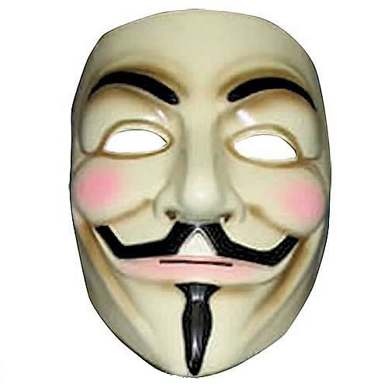

SQL Injection
Malicious user input employed to change the STRUCTURE of SQL statements instead of the VALUES on which these operate
Statements hijacked, and made to do unintended things, using full permissions of the application
Tricky
Inputs
Web Application
Changes
BAD
SQL
Retrieval
Database

Slide 10
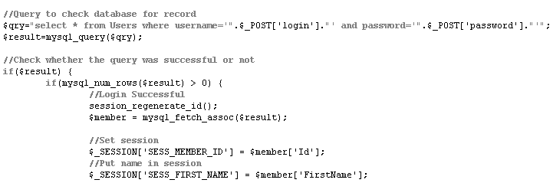
Vulnerable Code
Code excerpt from vulnerable PHP page handling login:
Query Users table to match supplied
username and password
If at least one record matches
Log user in as the matched account

Slide 11
The Trick
SQL statements created by concatenating SQL code fragments with user-supplied values
What if user-supplied values were constructed to contain SQL code fragments that changed the meaning of the statement?
What if we could turn it into a statement that matched records without matching on the username and password, as was intended?

Slide 12
Attack Strategy
Determine if application is injectable by putting special values (e.g., an apostrophe) in user input and seeing if an error is returned, suggesting that we have altered the structure of the code being executed
Imagine possibilities for what code in application might look like; Assume one for the sake of experimentation
Construct inputs that would change the code so that it is doing something different
If you get an error, you guessed wrong about what the code looks like; Assume a new variation and experiment with that
Once you get a working statement, vary it / elaborate it to discover the names of tables and columns through guesswork and the feedback provided by error messages
Use this knowledge to build additional statements until you have succeeded in making the application do your bidding

Slide 13
Demo Goals
Will attack http://www.frein.net/injection
Feel free to attack with me or on own time
Goal 1: Discover if app is SQL injectable
Goal 2: Log in without valid credentials
Goal 3: Escalate permissions to admin

Slide 14
Demonstration
[live attack on our sample application]

Slide 15
Prevention
Handle inputs safely:
  Stored procedures: values passed in can't become part of the executed statement
  Parameterized queries: ditto
  Object-relational mapping tools (e.g., Hibernate): will use parameterized queries in SQL it writes for you
  Escape or strip out special characters / commands (e.g., apostrophes): just make sure you get them all
Techniques for the above vary by database and programming language

Slide 16
Remember
SQL injection attacks are:
  Damaging ☹
  Easy ☹
  Preventable ☺

Slide 17
Questions?
  ???
  [Thank you.]

