Slide 1

Stephen Frein
5/27/2014

Slide 2

About Me
Director of QA for Comcast.com
Adjunct for CCI
https://www.linkedin.com/in/stephenfrein
stephen.frein@gmail.com
www.frein.com

Slide 3

Stuff We'll Talk About
Traditional (relational) databases
What is NoSQL?
Types of NoSQL databases
Why would I use one?
Hands-on with Mongo
Cluster considerations

Slide 4
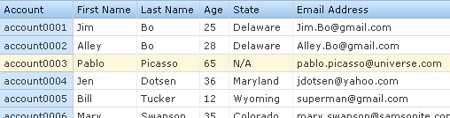
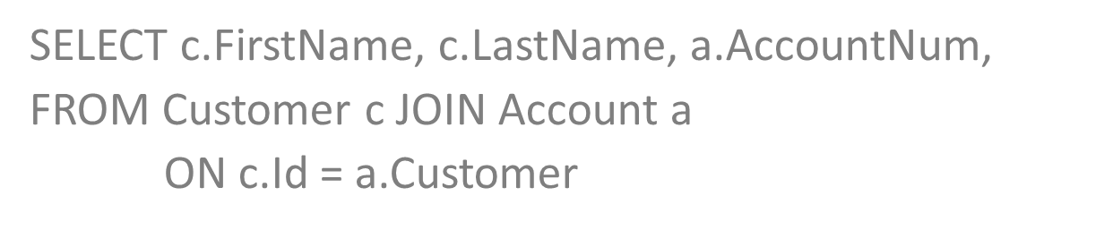
Relational Databases
Well-defined schema with regular, “rectangular” data
Use SQL (Structured Query Language)

Slide 5
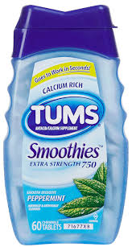
Relational Databases
Transactions* meet ACID criteria:
Atomic – all or nothing
Consistent – no defined rules are violated, and all users see the same thing when complete
Isolated – in-progress transactions can’t see each other, as if these were serialized
Durable – database won’t say work is finished until it is written to permanent storage
*sets of logically related commands – “units of work”

Slide 6
The Next Challenger
Relational databases dominant, but have had various challengers over the years
  Object-oriented
  XML
These have faded into niche use – relational, SQL-based databases have been flexible / capable enough to make newcomers rarely worth it
NoSQL is next wave of challenger

Slide 7

What is NoSQL?
“…an ill-defined set of mostly open source databases, mostly developed in the early 21st century, and mostly not using SQL.”
- Martin Fowler
Hard to say…

Slide 8

Loose Characterization
Don’t store data in relations (tables)
Don’t use SQL (or not only SQL)
Open source (the popular ones)
Cluster friendly
Relaxed approach to ACID
Use implicit schemas
↑ Not true all the time

Slide 9


Why Use NoSQL?
Productivity
  May be a good fit for the kind of data you have and the pace of your development
  Operations can be very fast
Large Scale Data
  Works well on clusters
  Often used for mega-scale websites

Slide 10
At What Cost?
Dropping ACID
  BASE (contrived, but we’ll go with it)
    Basically Available
    Soft state
    Eventually consistent
Data Store Becomes Dumber
  Have to do more in the app
  No “integration” data stores
Standardization
  No common way to address various flavors
  Learning curve

Slide 11
Flavors of NoSQL
  Key-value: use key to retrieve chunk of data that app must process (Riak, Redis)
  Fast, simple
  Example use: session state
  Document: irregular structures but can still search inside each document (Mongo, Couch)
  Flexibility in storage and retrieval
  Example use: content management

Slide 12
What Does Irregular Look Like?
Products:
Product A:
Name, Description, Weight
Product B:
Name, Description, Volume
Product C:
Name, Description
Sub-Product X:
Name, Description, Weight
Sub-Product Y:
Name, Description, Duration
Sub-Sub-Product Z:
Name, Description, Volume

Slide 13
Flavors of NoSQL
Graph: stores nodes and relationships (Neo4j)
  Natural and fast for graph data
  Example use: social networks
Column family: multi-dimensional maps with versioning (Cassandra, Hbase)
  Work well for extremely large data sets
  Example use: search engine

Slide 14
Productivity
Can store “irregular” data readily
Less set-up to get started – database infers structures from commands it sees
Can change record structure on the fly
Adding new fields or changing fields only has to be done in application, not application and database

Slide 15
Mongo Demo
We'll use MongoDb to show off some NoSQL properties
  Create a database
  Store some data
  Change structure on the fly
  Query what we saved
Go to http://try.mongodb.org/
We’ll enter commands here

Slide 16
Demo Code
Enter the following (one-at-a-time) at the prompt:
steve = {fname: 'Steve', lname: 'Frein'};
db.people.save(steve);
db.people.find();
suzy = {fname: 'Susan', lname: 'Queen', age: 30};
db.people.save(suzy);
db.people.find();
db.people.find({fname:'Steve'});
db.people.find({age:30});

Slide 17
Notice
The colon-value format used to enter data is called JSON (JavaScript Object Notation)
You didn’t define structures up front – these were created on the fly as you saved the data (the save command)
Steve and Susan had different structures, but both could be saved to “people”
Mongo knew how to handle both structures – it could search for age (and return Susan) even though Steve had no age define

Slide 18
Consider
How fast you can move and refine your database if structures are malleable, and dynamically defined by the data you enter
How you could shoot yourself in the foot with such flexibility

Slide 19
Ow – My Foot!
If you wrote code like this:
  emp1 = {firstname: 'Steve', lastname: 'Smith'};
  db.employees.save(emp1);
  emp2 = {firstname: 'Billy', last_name: 'Smith'};
  db.employees.save(emp2);
Then you tried to run a query:
  db.employees.find({lastname:'Smith'});
You’d be missing Billy (last_name vs lastname)
[
{"_id" :
{"$oid" : "529bdefacc9374393405199f“},
"lastname" : "Smith",
"firstname" : "Steve" }
]

Slide 20
Scalability
NoSQL databases scale easily across server clusters
Instead of one big server, add many commodity servers and share data across these (cost, flexibility)
Relational harder to scale across many servers (largely because of consistency issues that NoSQL doesn't emphasize)

Slide 21
CAP Theorem
Consistency – All nodes have the same information
Availability – Non-failed nodes will respond to requests
Partition Tolerance – Cluster can survive network failures that separate its nodes into separate partitions
PICK ANY TWO ☺

Slide 22
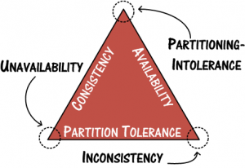
CAP Theorem

Slide 23
In Practice
If you will be using a distributed system (context in which CAP is discussed), you will be balancing consistency and availability
Questions of degree – not binary
Can sometimes specify the balance on a transaction-by-transaction basis (as opposed to whole system level)

Slide 24
NoSQL and Clusters
Replication: Same data copied to many nodes (eventually)
  self-managed when given replication factor
Sharding: Different nodes own different ranges of data
  auto-sharded and invisible to clients
Can combine the two

Slide 25
Distributed Processing
NoSQL clusters support distributed data processing
Basic approach: Send the algorithm to the data (e.g., MapReduce)
Map – process a record and convert it to key-value pairs
Reduce – Aggregate key-value pairs with the same key

Slide 26
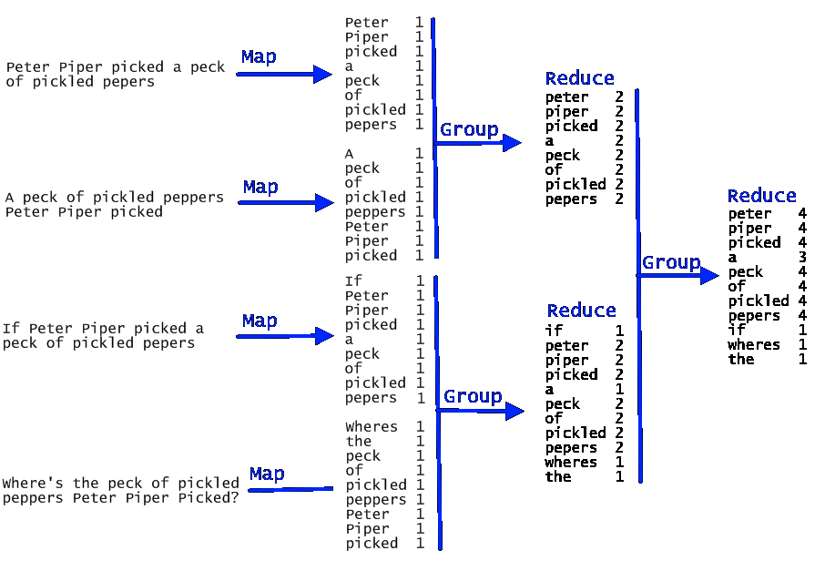
MapReduce Visualized

Slide 27
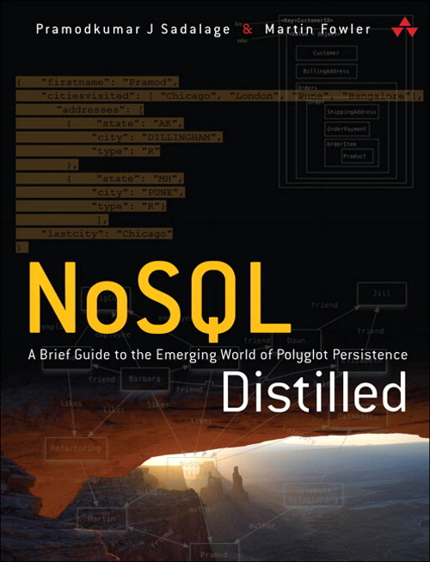
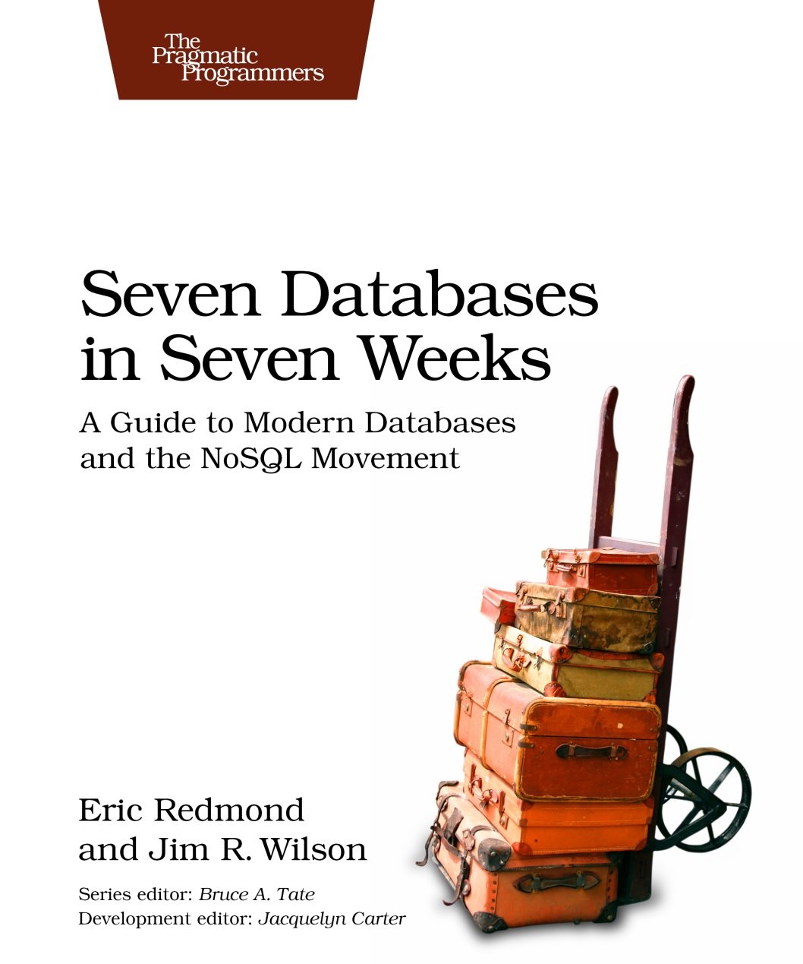
Learn More

Slide 28
Wrap-up
Questions?
Thanks!

